Slide 1
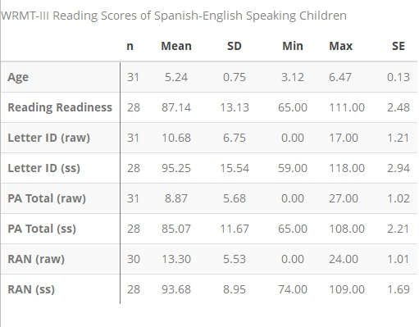
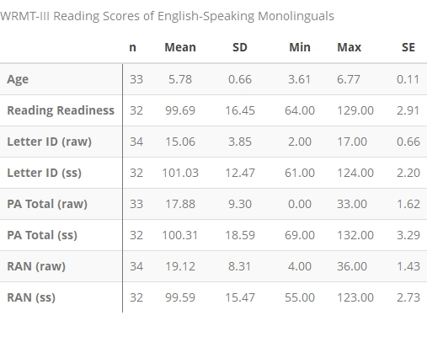
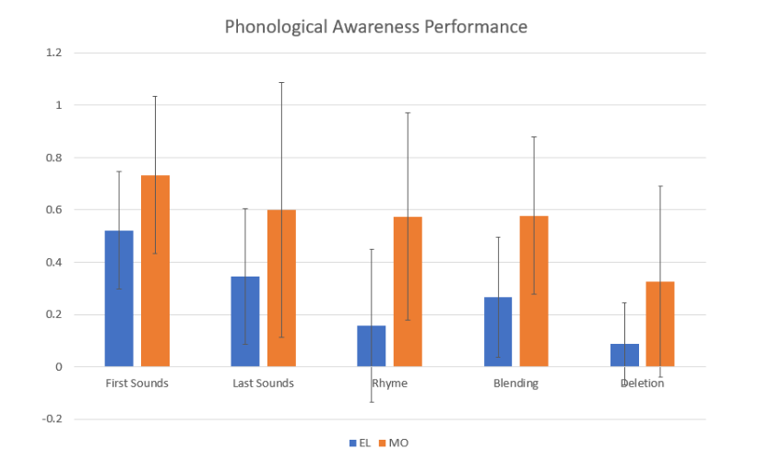
Spanish-English learners score lower on phonological awareness tests than their English-speaking monolingual peers.
Non-Cognitive Predictors of Student Success: A Predictive Validity Comparison Between Domestic and International Students
Non-Cognitive Predictors of Student Success: A Predictive Validity Comparison Between Domestic and
The Performance of Spanish-English Speaking Children on Phonological Awareness Tests as Compared to their Monolingual English-Speaking Peers
Molly Morgan and Dr. Lisa Fitton
INTRODUCTION
Less than 10% of English learners in the U.S. meet criteria for reading proficiency in 4th grade, whereas 47% of their monolingual peers meet criteria
Reading performance in the early elementary grades is a strong predictor of later academic achievement
Few tools have been examined closely for reliability and validity with Spanish-English speaking children
METHODS
This study reviewed the performance 65 who were Spanish-English speakers (ELs) or monolingual speakers (MOs) between the ages of four and six on the emergent literacy section of the Woodcock Reading Mastery Tests, Third Edition
The number and type of errors made were analyzed
RESULTS
When controlling for age, there were no significant differences between monolingual and English learners on Letter ID and Rapid Automatic Naming
MOs scored between 2.30 and 9.14 points higher, with an average of 5.72, than ELs on the phonological awareness (PA) portion of the test
MOs had a higher mean score on every section of the PA task (First Sound, Last Sound, Rhyme, Blending, and Deletion) with the largest difference in mean scores between English learners and MOs being found on the rhyme, blending, and deletion sections
DISCUSSION
This research will aid in the development of improved phonological awareness tests that are more accurate and this will in turn lead to stronger interventions, heightened academic achievement, and enhanced life outcomes for Spanish-English speakers in the U.S.
This research indicates that when measuring dual-language learners (DLLs) literacy development, cultural and linguistic factors that may influence performance should be considered
However, there are still gaps in emergent literacy between DLLs and MOs that need to be addressed through explicit instruction
Take a picture to learn more about this project

